Slide 1

W209 Midterm Presentation
Football Fantasy League Helper
Michelle Liu, David Jablonski, Shane Conner

Slide 2
Domain
Draft and manage roster
NFL players
(16) positions
Select Starters
(1) Quarterback
(2) Runningbacks
(2) Wide Receivers
(1) Tight End
(1) FLEX (RB, WR, or TE)
(1) Placekicker
(1) Defense
Score Points
Reflective of actual player performance
Compete head-to-head
10 Teams (Typical)
Top score wins
Isolated to match up
Notes:
The premise of Fantasy Football is where participants draft and manage a roster comprising of NFL stars. Each week, the user selects from their roster to form a ‘starting’ team which is typically:
(1) Quarterback
(2) Running Backs
(2) Wide Receivers
(1) Tight End
(1) Placekicker
(1) Team Defense
(1) FLEX position (can be RB, WR, or TE)
The user’s starting team scores points based on the actual weekly performance of the selected starting player. Teams use these player points to compete against other league members in head-to-head matchups each week of the season with the winner of the matchup as the team with a higher point total. The scores of other league members outside of the matchup are irrelevant to reflect the nature of the NFL season.

Slide 3
Users
Any participant of Fantasy Football
New Users
Simplifying Football data in comprehensible, familiar terms
Overcome disadvantages due to inexperience --bridge the gap.
Veteran users
Interested in exploring the Fantasy Football data through a different view
Assist in substantiating educated decisions
Notes:
The users in this case are intended to be any Fantasy Football participant. Saying that, we want to create a visualization that is useful for both veterans and new users alike.
Firstly, new users with relatively little knowledge of current NFL players can be at a disadvantage when selecting players compared to veteran league members. There is a large amount of expert and analyst information available but that isn’t necessarily helpful if the user isn’t aware what this data means. We want to simplify that information and visualize it in a familiar format to ultimately bridge the gap between new users and veteran users.
For veteran players, we want to build a visualization that is fun to interact with, despite their preexisting knowledge, by allowing them to explore the data they’re familiar with through another view and ultimately, assist in substantiating decisions.

Slide 4
Tasks
Aggregate player data
“Wisdom of the crowd”
Average Projected Points
Lower & Upper Point Intervals
Consensus Position Rank
Feature Engineer
Value Over Replacement (VOR)
Exploration
Allow users to set visualization views
Search and Filter
Search for specific players
Filter irrelevant data
Notes:
To do so, we will aggregate, transform, and visualize expert data in a concise, yet comprehensive manner.
To aggregate the data, we have created a R script which pulls the data from a multitude of sources. In doing so, we’re able to retrieve the “wisdom of the crowd” on both the projected number of points, a continuous data type, and expert consensus rankings for each player position, ordinal dating. Additionally, we can determine the upper and lower interval bounds of this data using their standard deviation which allows for more methods of visualization.
Since player positions tend to cluster around certain ranges of points, we will feature engineer a variable called “Value Over Replacement” which essentially is a player’s difference in projected points from their position’s average projected points. This is helpful because it standardizes points across positions and helps inform the user of a player’s value relative to all of the players –not just their position.
We want to encourage user exploration of the data to inform their own insights through individual interaction. To do so, we want to implement a visualization that allows the user to swap variables and morph the visualization as they see fit.
Moreover, the visualization will allow users to filter out irrelevant data and also search for a specific player. This will help inform decisions such as “who to start” , “what player to drop”, and “who to pick up off the waiver wire”.
And with that I’ll pass it onto Michelle to discuss the data.

Slide 5
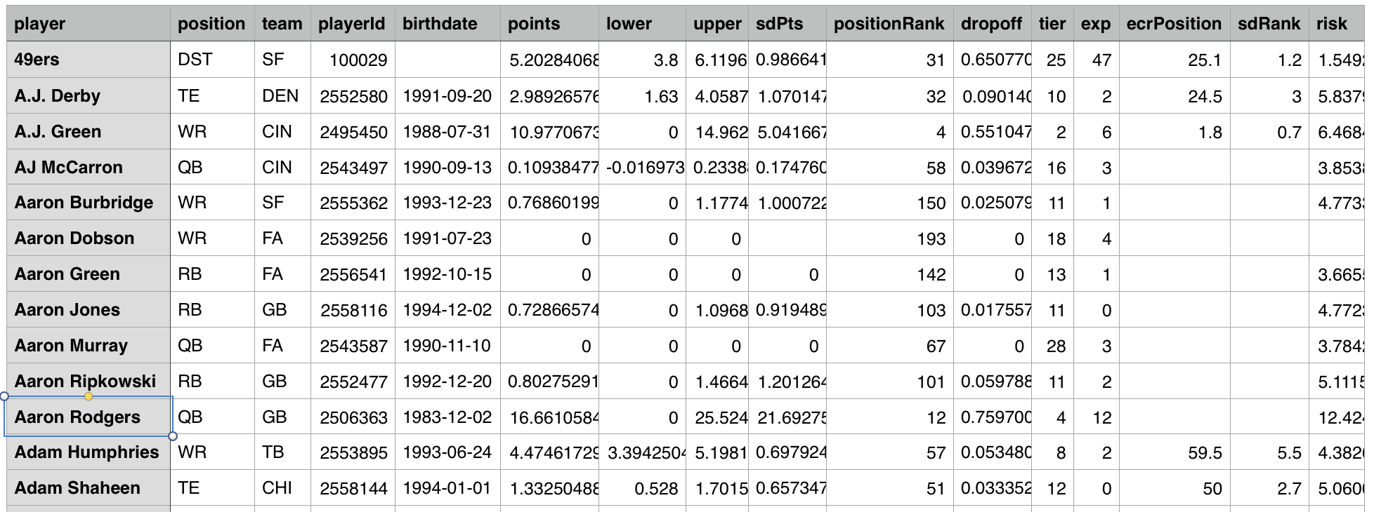
Data
Generated our dataset from a R package that scrapes and aggregates player data from various websites
Notes:
Michelle
Like previously mentioned, we have a R script that pulls and aggregate the data from various websites such as ESPN, CBS, NFL.com, FantasyPros, and many more. Here is an example of the output from our csv file. We will further talk about what transformation we did to our variables in Tableau.

Slide 6
Iterations of Design
Decided to go with Tableau
Variables to include in the visualization:
Projected Points
Ranking
Name
Team
Position
Value Over Replacement
Standard deviation of projected points
Notes:
David
In choosing a platform for our dashboard we decided to play to our strengthens. Each of us has used Tableau before. This will give us more time to focus on the visualizations.
The Variables that we intend to display are listed on the chart. I wanted to call to attention that we’ll be starting with the known breakouts and then be moving to the higher order metrics.

Slide 7
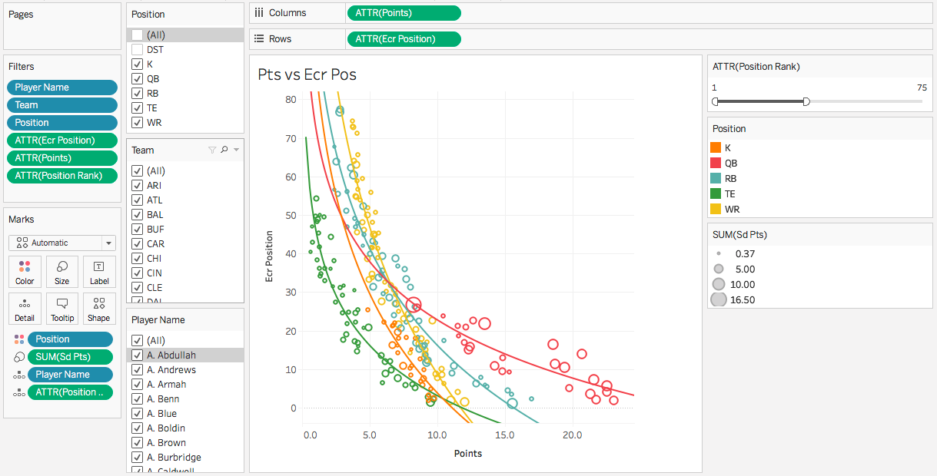
Experimenting with our data

Slide 8
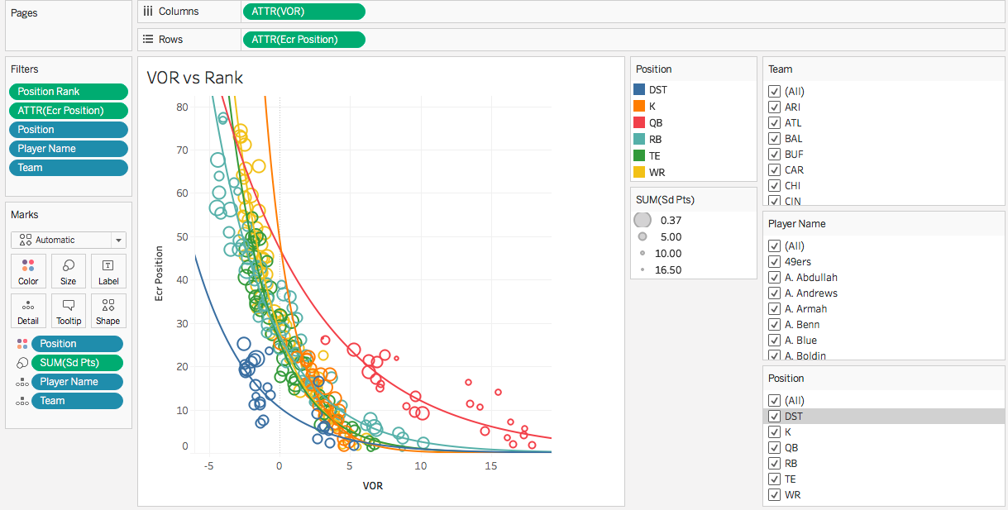
Experimenting with our data

Slide 9
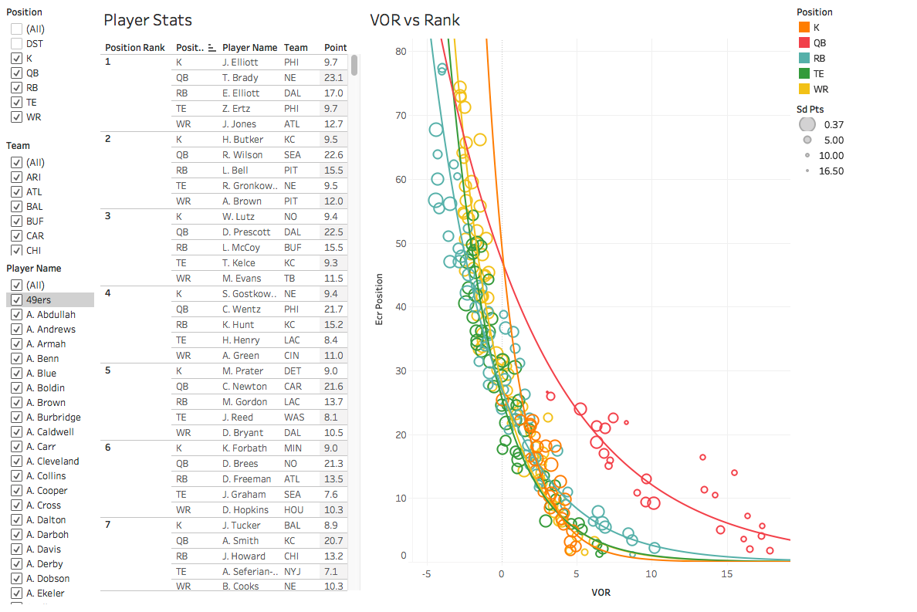
Current Dashboard
Notes:
Michelle
In Tableau, we created a sheet that basically summarize each player’s information so the users can look at the top ranking players for each position.
For visualization, we have one with Points versus their Average Position Rank, with the sizes representing the standard deviation in points. Here, the users can select the position they are looking for, select or deselect teams and players name based on their availability, and identify players who are consistently scoring well.
To filter out non relevant players. We applied a filter to only show the top 75 players.
Similarly, we tried one but use Value Over Replacement instead of Points. We then put together a dashboard that combines the player’s stats summary, all the different filters, and the VOR vs Position Rank plot. We are still exploring the different methods to show the data. Our future goals include connecting the Player Stats and the visualization so highlighting one will highlight the other. We will continue to explore different representation of our data, and attempt to incorporate user's league specific information for better user experience.

Slide 10
Testing Plan
Options for User Testing that were not elected
Originally using a web-based User Testing site like usertesting.com
Looked at using Tableau Online
Plan for User Testing
Test Subjects
5-10 MIDS students who have Tableau or can download Tableau Reader
Mix of New and Veteran Users
Delivery
Use ISVC Meeting to share User screen
Step 1 - Guided discussion through the dashboard
Step 2 - User is given a flex player scenario and asked to provide recommendation
Notes:
David

Slide 11
Questions & Feedback
Please email any questions and feedback about our project to:
michelleliu103@berkeley.edu
shane.conner@berkeley.edu
david.jablonski@berkeley.edu

